Slide 1
A Contextual Behavioral Science Framework for Intentional Cultural Change
Anthony Biglan, tony@ori.org
Dennis Embry, dde@paxis.org

Slide 2
Relevant Papers
Biglan, A & Embry, D. D. (in press), A Framework for Intentional Cultural Change. Journal of Contextual Behavioral Science
Wilson, D. S., Hayes, S. C., Biglan, A., & Embry, D. D. (2013). Evolving the future: toward a science of intentional change. Brain and Behavioral Science, in press.
Biglan, A. & Cody, C. (2013). Integrating the human sciences to evolve effective policies. Journal of Economic Behavior and Organization.

Slide 3
The Scientific Goal of Contextual Behavioral Science
“The development of the scientific principles and theories [that] enable the prediction and influence of the historically and situationally embedded actions of organisms with precision, scope, and depth.” (Hayes & Long, 2013).
Multi-level analyses of evolutionary processes teach us that it is useful to view evolution from the level of DNA to the level of organizations as a matter of the relative degree of selection of the individual unit vs. the group of units.
  “It’s groups all the way down.”

Slide 4
From this perspective
“…the embedded actions of organisms…” can be viewed as including what groups or organizations do.
Thus, although the CBS framework has mostly been applied to the behavior of individuals, the goals and principles of the analysis are just as relevant to the analysis of the actions of organizations.

Slide 5
“…an analysis need only go so far that ‘effective action can be taken’ (Skinner, 1974, p 210)” (Hayes and Long, 2013)

Slide 6
Intentional Cultural Evolution

Slide 7
A Goal for Intentional Cultural Evolution
Increasing the prevalence of wellbeing in the population
Think about the evolution of the behavioral sciences over the past fifty years.

Slide 8
Public Health Definition of Wellbeing
Increase the incidence and prevalence of the constellation of behaviors and values labeled Prosociality
Decrease the incidence and prevalence of the constellation of behaviors and values involving antisocial behavior and related problems

Slide 9
Prosociality
A constellation of behaviors, values, and attitudes that involve cooperating with others, working for the wellbeing of others, sacrificing for others, and fostering self-development.
Associated with
  fewer behavioral problems (Caprara, Barbaranelli, Pastorelli, Bandura, & Zimbardo, 2000; Kasser & Ryan, 1993; Sheldon & Kasser, 1998; Wilson & Csikszentmihalyi, 2008),
  doing better in school (Caprara et al., 2000),
  more and better friends (Clark & Ladd, 2000),
  better health (Biglan & Hinds, 2009).
  More successful in business (Channer & Hope, 2001).

Slide 10
The Value of Prosociality for the Group
Cooperative groups can out-compete groups with few prosocial members (Henrich, 2004; Kasser, 2004; Sober & Wilson, 1998; Wilson et al., 2013).
Prosocial individuals contribute more to their communities (Wilson & O’Brien, 2009).
Countries with a higher proportion of people endorsing prosocial values are higher on measures of children’s wellbeing, provide better maternal leave benefits, advertise less to children, and emit less C0² (Kasser, 2002)

Slide 11
Antisocial Behavior and Related Problems
Directly anti-social: aggression, homicide, theft, fraud
Risky sexual behavior
Substance abuse
Academic failure
Depression and anxiety

Slide 12
Environments that Nurture Prosociality and Prevent Multiple Problems
Minimize toxic biological and social conditions
Teach, promote, and richly reinforce prosocial behavior
Monitor and limit opportunities for problem behavior
Promote psychological flexibility

Slide 13
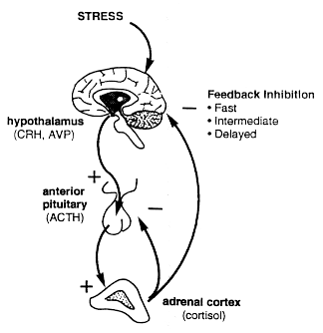

Minimize toxic conditions: the physiological stress response

Slide 14
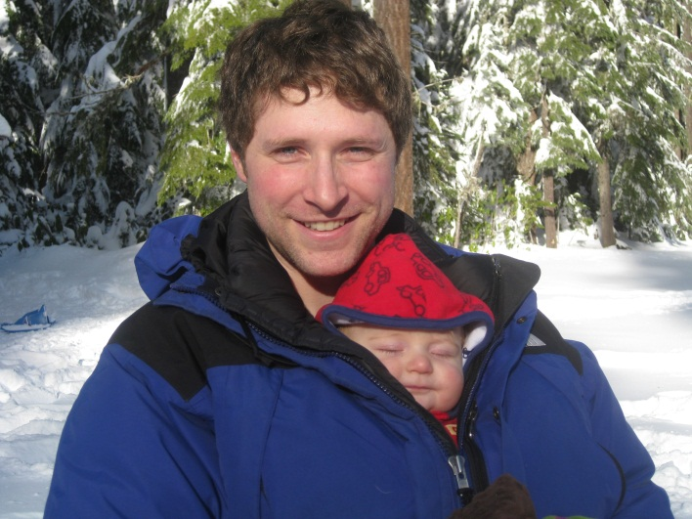

Slide 15
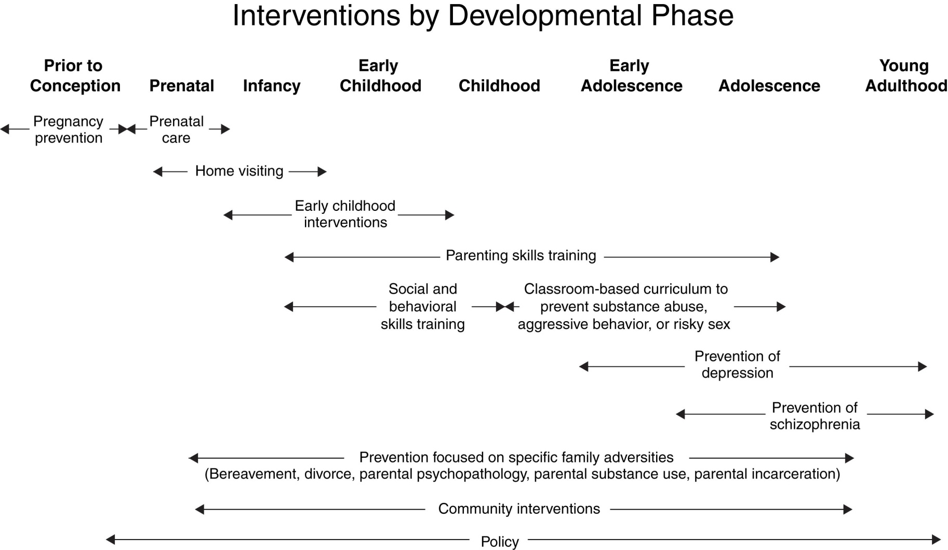
Notes:
This is a developmentally oriented diagram that shows how we might think about prevention. In the report in several major chapters, we document the evidence for these different kinds of interventions. Early in life: prenatal care, home visitation, high quality daycare have a very strong evidence base for preventing a variety of disorders later. Into childhood, we have general interventions like parent skills training that have a strong knowledge base and more specific interventions such as prevention of depression. Across the bottom of the diagram, there is a very strong evidence base for family adversity intervention. By community interventions, we should recognize that we mean not just ways to strengthen communities but also addressing poverty, addressing violence, and addressing social isolation and also that policy is absolutely key.
Multiple opportunities for intervention across young people’s developmental course
In some cases, specific interventions are ties to a particular developmental stage given the emergence of symptoms and disorders at that stage (e.g., substance abuse, depression), but earlier interventions can lay the foundation for success
Ideally, a given intervention would not be delivered in isolation but within a broader network of a community system of supports.

Slide 16
“The scientific foundation has been created for the nation to begin to create a society in which young people arrive at adulthood with the skills, interests, assets, and health habits needed to live healthy, happy, and productive lives in caring relationships with others.”

Slide 17
Positive Parenting Program —Triple P*
A community-wide system of parenting supports that includes
  Brief media communications
  Brief advice for specific problems
  More extensive interventions when needed
Multiple randomized trials showing benefit
Including an RCT in 18 counties in South Carolina¹⁴
* Funded in part by NIDA

Slide 18
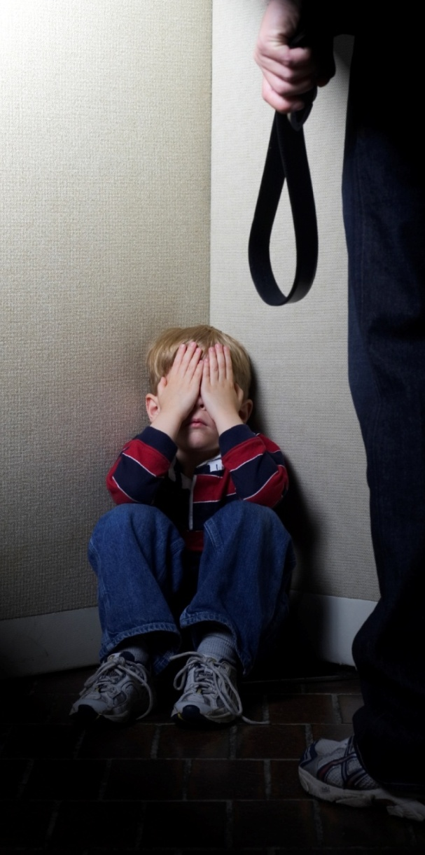
Substantiated child maltreatment
Before Triple P
After Triple P
Effect size = 1.09, p <.03. Triple P stopped a rising trend of substantiated child-maltreatment in counties using Triple P, compared to counties not receiving Triple P.

Slide 19
The Family Check-Up
Provides parenting support to families of young children (age 2 and 3) and early adolescents
Format
  A strengths-based focus
  Three sessions: Initial Interview, Assessment, Feedback
  Additional assistance if needed
  Annual check-ups are available
Benefits for young children
  Significant lower levels of aggressive and oppositional behavior at age 8 ½
  Significantly better academic achievement at age 7 ½

Slide 20
Probability of Arrest
(Connell, Dishion et al, 2008).
Ec
E
Ei
N
N
N=Non-engaged
E=Engaged
11 12 13 14 15 16 17
Age in Years

Slide 21
Evidence-based Family Interventions Through The Lifespan
Program | Developmental Phase
Nurse Family Partnership¹ | Prenatal through infancy
Healthy Start² | Prenatal through infancy
Family Check-Up³⁻⁸ | Early childhood through early adolescence
Parent Management Training Oregon⁹ | Childhood
Incredible Years¹⁰⁻¹¹ | Early childhood through childhood
Multisystemic Therapy¹² | Adolescence
Multidimensional Foster Family Care¹³ | Early childhood and adolescence

Slide 22
Evidence-based school interventions affecting social, behavioral, and academic outcomes
e-Circle Professional Development for Preschool Providers
Providing Alternative Thinking Strategies/PATHS
Positive Behavior Intervention and Support
Positive Action¹⁹
Seattle Social Development Program

Slide 23



The Good Behavior Game
Classroom teams in elementary school earn small rewards for being on-task and cooperative

Slide 24

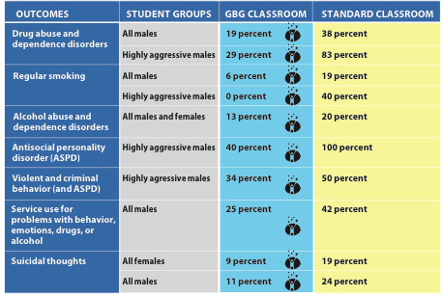


First graders exposed to GBG for one year had these benefits at age 21.
Read this and other GBG studies at www.pubmed.gov

Slide 25
Evidence-based kernels
Simple empirically supported behavior-influence techniques
More than 50 have been identified²³
Examples
  Prize Bowl, to reduce serious addictions and complete recovery goals
  Beat the Timer
  My Values activity, to increase high school graduation rates
  Omega 3 supplementation
  Praise notes

Slide 26
Types of Kernels

Slide 27
Evidence-Based Policies
http://promiseneighborhoods.org/policies/

Slide 28
Effective Action Requires
An effective analysis of the action of organizations

Slide 29
The Influence of Corporate Externalities on Human Wellbeing
The impact of a market transaction on parties not directly involved in the transaction
  Mercury emissions
  Materialism
  Credit default swaps
Marketing
  Tobacco
  Alcohol
  Unhealthful food
  Pharmaceuticals
  Materialism

Slide 30
The Impact of Poverty and Economic Inequality on Wellbeing

Slide 31
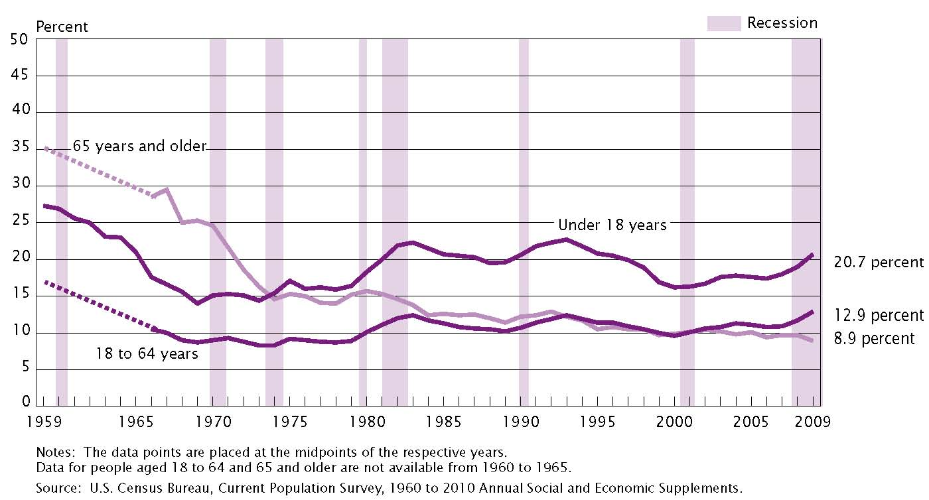
U.S Poverty rates by age: 1959 to 2009

Slide 32
Parenting: A key pathway from poverty to problem development
Family poverty produces strains on parents that undermine their parenting⁴⁵⁻⁴⁷
Parents under financial strain are less likely to be positively involved with their children and are more likely to criticize and argue with them⁴⁸

Slide 33
Perturbed parenting leads to
Children and adolescents being more anxious and depressed⁴⁸⁻⁴⁹
Failure in school⁴⁸
Aggressive behavior⁴⁷
Delinquency⁵⁰

Slide 34
Health and social problems are closely related to inequality in rich countries
Worse
* USA
Portugal *
UK *
Index of health and social problems
Greece *
* New Zealand
Austria *
Ireland *
Australia *
France *
Germany *
* Canada
Italy *
Denmark *
*
Belgium
* Spain
Finland *
*
Netherlands
* Switzerland
Norway *
* Sweden
Better
* Japan
Low
Income Inequality
High

Slide 35
The Evolution of Corporate Capitalism

Slide 36
The principle of selection by consequences
Practices of groups and organizations are selected and maintained by their material consequences
  Glenn S.S. (2004) Individual behavior, culture, and social change. The Behavior Analyst, 27, 133-152
  Harris, M. (1979). Cultural materialism: The struggle for a science of culture. New York: Simon & Schuster.
  Ponting, C. (1991). A green history of the world: The environment and the collapse of great civilizations. London: Penguin.
  Wilson, D. S. (2003) Darwin’s cathedral. Chicago: University of Chicago Press

Slide 37
The Tobacco Industry

Slide 38
R. J. Reynolds’ Camel marketing campaign—1913-1921

Slide 39
First camel campaign increased the number of male smokers
Men born 1890-1899)
% Smokers
Men born before 1890
Women born before 1899
SOURCE: Pierce & Gilpin, 1995

Slide 40
The result
Reynolds’ market share rose from 0.2% to 50%

Slide 41
A Brief History of the Evolution of Poverty Producing Policies
The Lewis Powell memo
Development of advocacy organizations
Development of a conservative leadership class
A set of policy objectives
The media
Religious fundamentalism

Slide 42
Policies that Affected Inequality
Between 1970 and 2000, the top 0.1 percent went from earning 1.2% of total national after-tax income to earning 7.3%.
  Had tax policy not reduced their taxation, their share would have increased to only 4.5%.
Disparity also grew because of the failure of political leaders to update policies in keeping with changes in the economy.

Slide 43
The policies include:
Failure to index the minimum wage to inflation
Failure to adopt healthcare reforms that could have dealt with the increasing costs of healthcare for individuals and companies
Failure to regulate CEO compensation (CEOs in the U.S. earn more than twice the average of those in other developed nations.)
Failure to regulate new financial instruments such as derivatives
The erosion of company-provided pension plans

Slide 44
In sum…
Economic policy changed over the last 40 years as a function of advocacy and political control by business interests
These policies have been directly beneficial to those in political power, but diminish economic wellbeing of those in the lower half of income distribution
And ultimately all of us.

Slide 45
“…one of the 10 greatest achievements in public health in the 20th century…”

Slide 46
Key features of the tobacco control movement
An expanding network of epidemiological evidence—effectively delivered to opinion leaders
A growing body of evidence-based programs and policies that affect smoking
A network of advocacy and public health organizations
Surveillance system

Slide 47
Implications

Slide 48
Effectively communicated epidemiological evidence
The influence of toxicity and psychological flexibility on wellbeing in populations
Surgeon General Reports, etc.
Creative epidemiology
  News stories
  Entertainment media
  Social media
  Advocacy for nurturance

Slide 49
Widespread implementation of evidence-based programs, policies, and kernels
Making evidence-based treatment available to everyone who needs it.
Providing brief, minimally sufficient supports for nurturance in entire populations
Implementing policies that affect wellbeing
  Controls on advertising
  Policies that affect poverty and inequality

Slide 50
Bottom Up and Top Down

Slide 51
Recent Replications of GBG

Slide 52
Build a network of increasingly effective advocacy organizations
Imagine that ACBS articulated an increasingly accurate and elaborate account of what is needed to improve human wellbeing.
That ACBS networked with other scientific and advocacy organizations to articulate, widely communicate, and advocate for the programs, policies, and practices needed to improve human wellbeing.
That ACBS fostered research on how to strengthen the support for and effectiveness of advocacy organizations.

Slide 53
A comprehensive surveillance system
In order to evolve more effective systems for supporting wellbeing, we need ongoing data about the prevalence of wellbeing and the prevalence of the programs, policies, and practices that affect wellbeing.

Slide 54
“…create a society in which young people arrive at adulthood with the skills, interests, assets, and health habits needed to live healthy, happy, and productive lives in caring relationships with others.”

